Slide 1
THOMSON REUTERS:
THE ARCHITECTURE OF AN INFORMATION BUSINESS
Bob Bailey
Chief Information Architect, Thomson Reuters
Integrated Enterprise Architecture Conference, London
March 3-4, 2015

Slide 2
About Thomson Reuters
Financial & Risk
Legal
Critical news, information & analytics, enables transactions, and connects trading, investing, financial and corporate professionals.
Critical information, decision support tools, software & services to legal, investigation, business and government professionals.
Intellectual Property & Science
Tax & Accounting
Integrated tax compliance and accounting information, software
& services for professionals in accounting firms, corporations, law firms and government.
Comprehensive IP & scientific information, decision support tools & services to enable governments, academia, publishers, corporations &
law firms.
Reuters News
Powered by more than 2,800 journalists reporting in 20 languages from bureaus around the world, Reuters is the world’s largest international news organization
Notes:
Large global information business operating in a number of information domains, reflecting different types of professional activity
Grown through acquisition so high tech & info diversity
Historically, info business = adding value by sourcing, curating and providing access

Slide 3
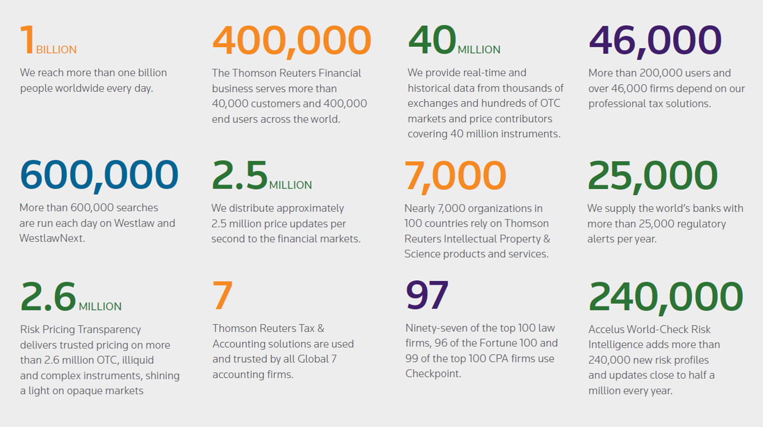
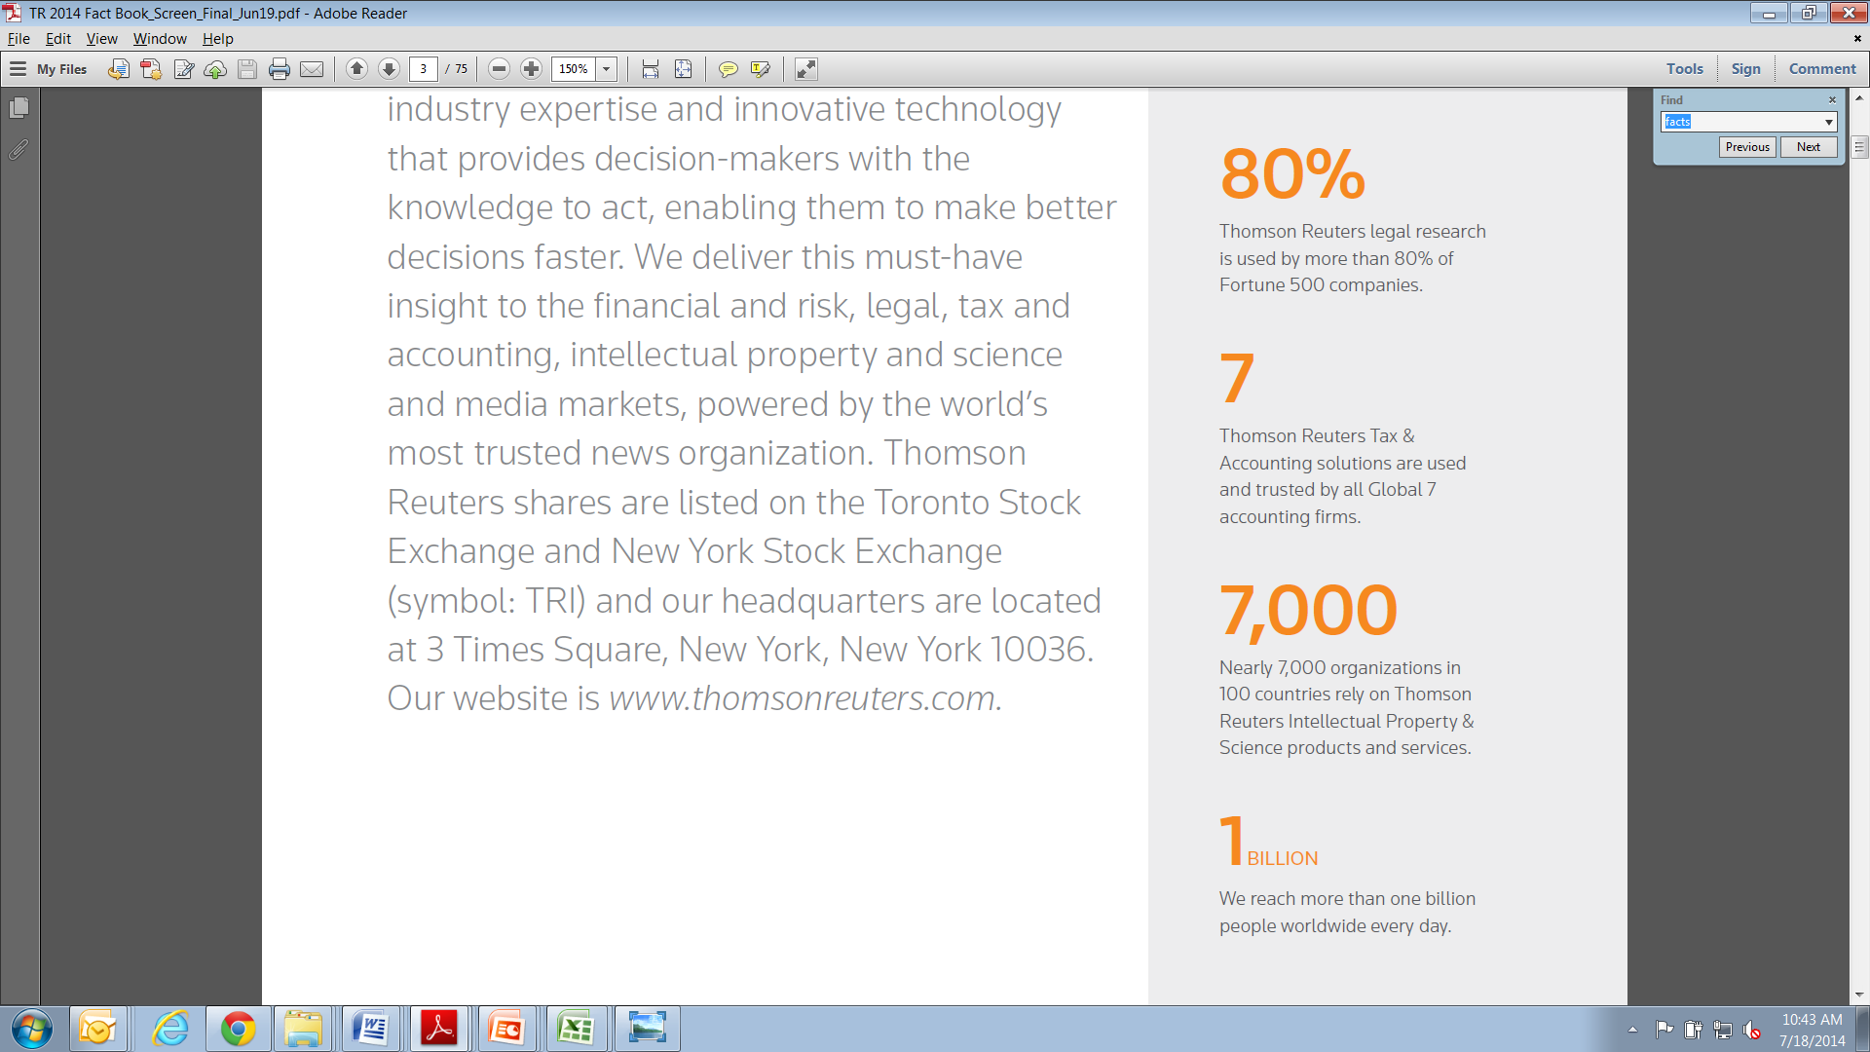
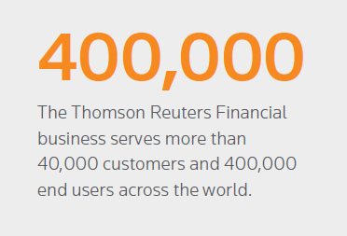
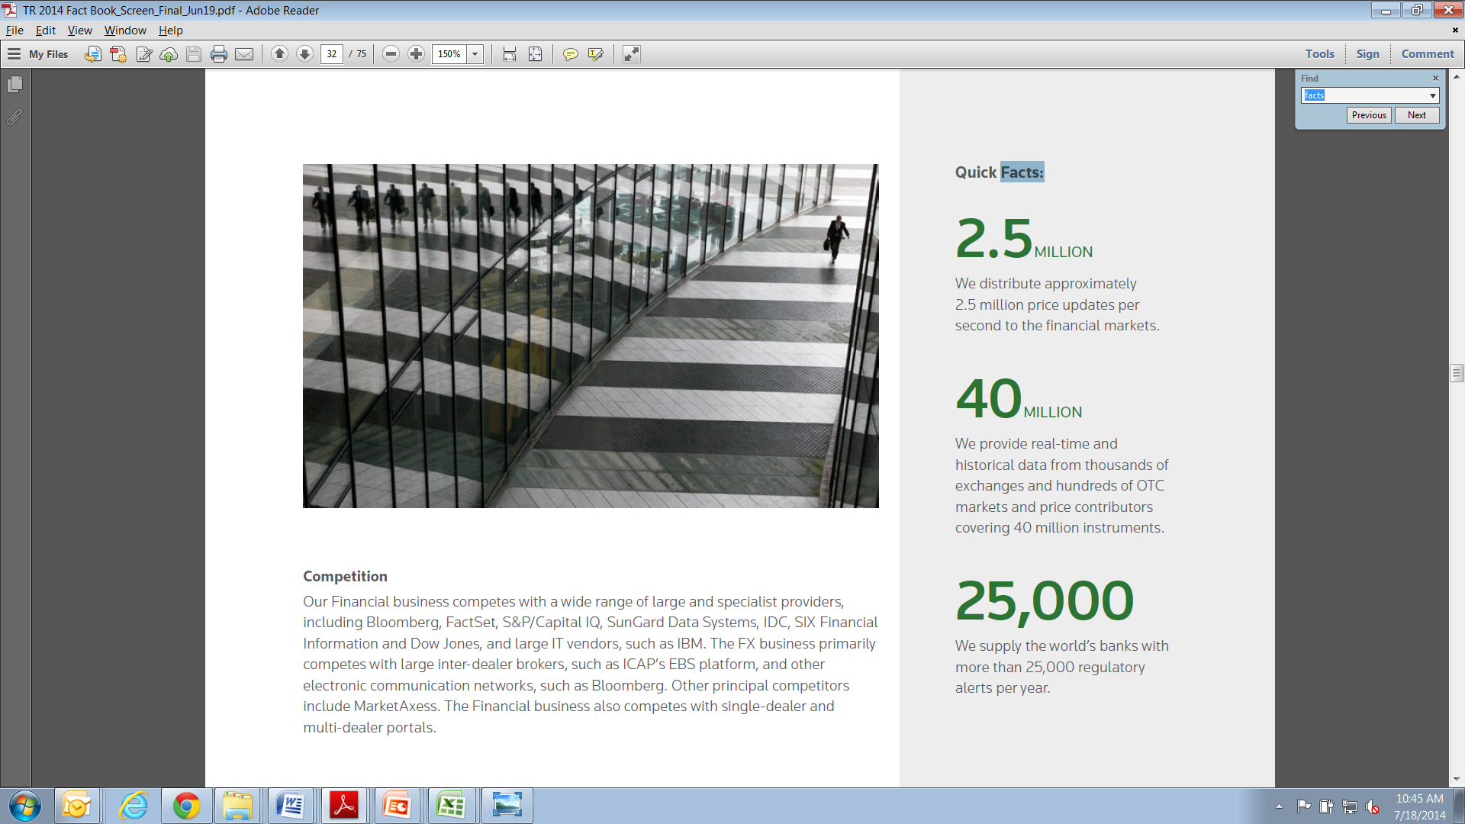
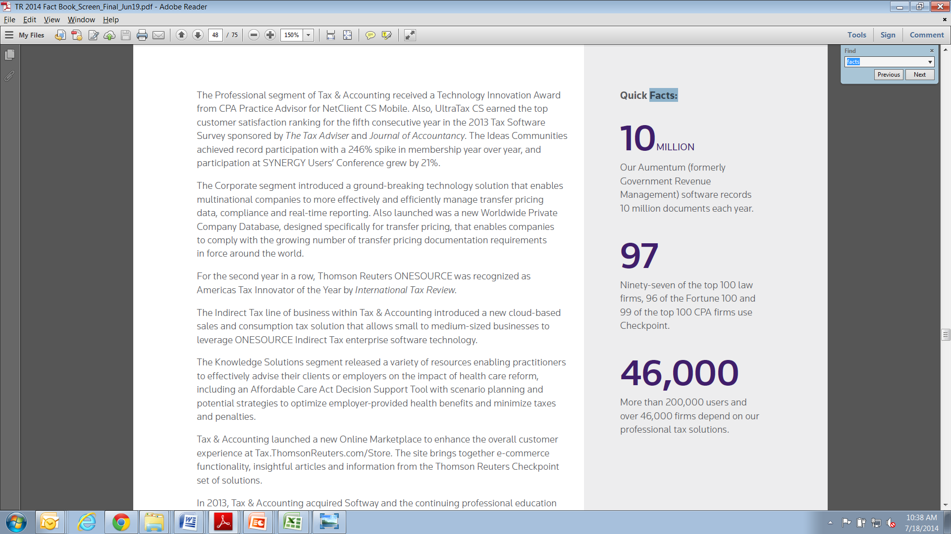
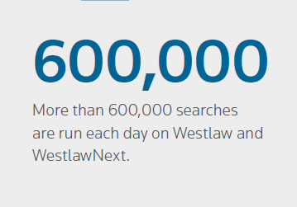
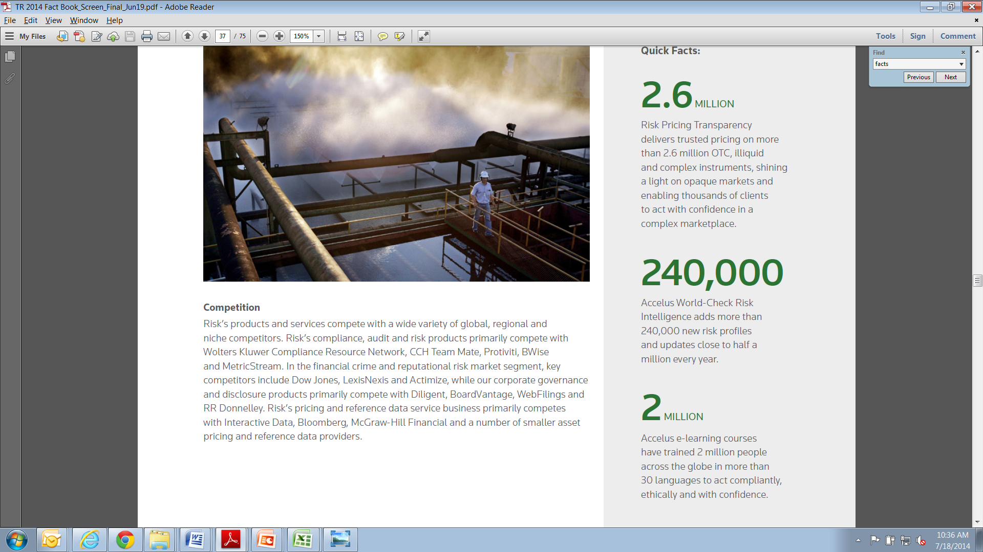

THOMSON REUTERS – KEY FACTS
3
PRIVILEGED & CONFIDENTIAL
Notes:
Not big in volume standards (by todays measures) but big in terms of variety, velocity, veracity etc.

Slide 4

Making sense of the flood of information
Help customers make sense of the tidal wave
of information through
tools such as predictive analytics and visualization
Help customers spot patterns and outliers,
and find signals
through the noise
Provide high quality authoritative facts as a solid foundation for workflow and hypothesis validation
A robust information architecture enables Thomson Reuters to
Run, build and use scalable infrastructure and platforms
Leverage all of our information assets for the benefit of all of our products and services
Help our customers more effectively operate their own big data operations
Notes:
How we see our mission

Slide 5

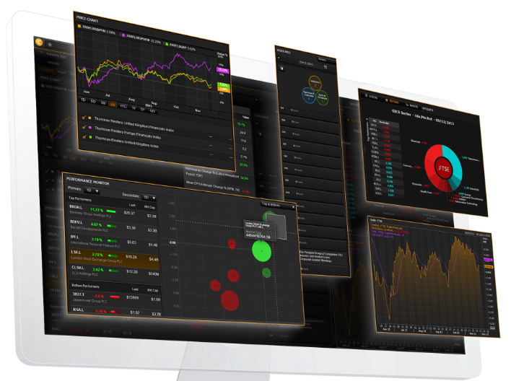
Notes:
Grown through acquisition
Front end integration 10 years ago
Moved to get a federated data governance framework in place – now the content is connected and can be used in many more diverse ways

Slide 6
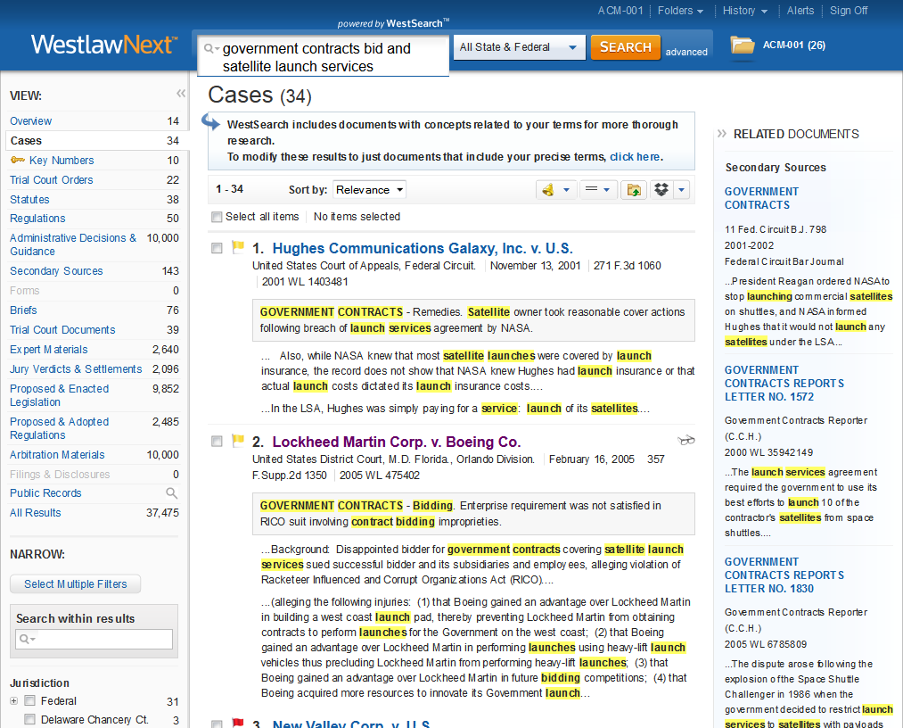
Notes:
Similarly grown through acquisition, with a focus on document artefacts rather than structured data

Slide 7
Information scale & ubiquity
 | Past | Future
Pattern | Silos | Federated, social
Modularity, Modelling | Closed, Normalised | Open, Described
Content method | Curate | Curate & Aggregate
Storage paradigm | Document warehouse / relational | Data + Compute as a platform
Knowledge paradigm | Facts or Documents | Hybrid, Graph
User as | Human 1st, Machine 2nd | Machine 1st, Human 2nd
IA focus | Data models, UX | Methods, standards
One person, group, organisation cannot do everything
The response has to be collective – internally, with customers & partners and with competitors
Increasing value in services helping others use content (compared to value in content)
Notes:
Change has been tectonic & is still ongoing

Slide 8
Content Architecture
LEGACY PRODUCT
(Existing Business Systems)
NEW PRODUCTS
(New Business Systems)
ACQUIRE & INGEST
(Content Operation Systems)
PUBLISH & DELIVER
(Customer Facing Systems)
ENHANCE - CURATE & CREATE
(Content Management Systems)
Content Management
Content Movement
Content Enhancement
Content Analytics
1
2
3
4
Secuirty, Compliance, Data Protection
Taxonomy, Data Model, Directory
System Management
Logging & Monitoring
STORE & DISTRIBUTE
(Core Platform)
Data & Computation (Data Lake, BOLD, Knowledge Graph)
Data Center Operations
(support)
Networks & Service
(support)
Core Platform Operations
(support)
Legend
1
Describing our data – ability to chronicle our data (e.g. provenance, metadata and permissions)
2
Managing the data journey – manages the data flow from acquisition and ingest to storage destination
3
Enriching our data - ability to enhance our data (e.g. entity identification, translations services, data cleansing & data quality management)
4
Extracting value from our data – ability to intelligently search and analyse our data (e.g. Natural Language Processing and Machine Learning)

Slide 9

Identity versus Identifier
  Identity is information intended to pick out an individual topic or entity
  An Identifier is a token representing that information
  Identifier schemes package up the management of identity, the syntax & use of the identifier and the method for assignment of one to the other
Notes:
One facet is identity...many others, this illustrates overall approach

Slide 10
Information Identity
In a federated information sharing environment, identity must be agreed if data exchange is to be precise
    Cant be controlled or imposed as in a single domain system
    Cant be mapped or interpreted as not precise enough
  This same constraint applies to analysis of aggregated, multi-source data
  Agreement is a social activity, not an inherently technical one
A common reference point can make agreement easy to achieve
    Especially if it adds value to individuals as well as to groups
Notes:
In federated large scale systems, the effort required to map or interpret identity exceeds the effort required to motivate use of a common reference point
It is just a different sort of effort

Slide 11
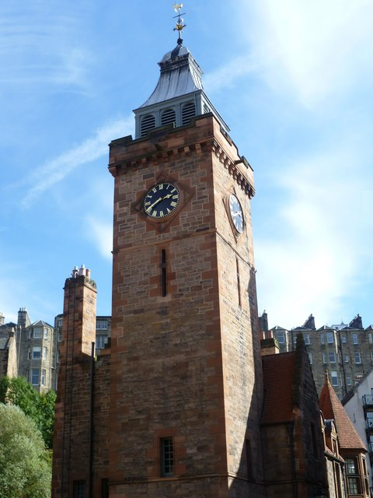
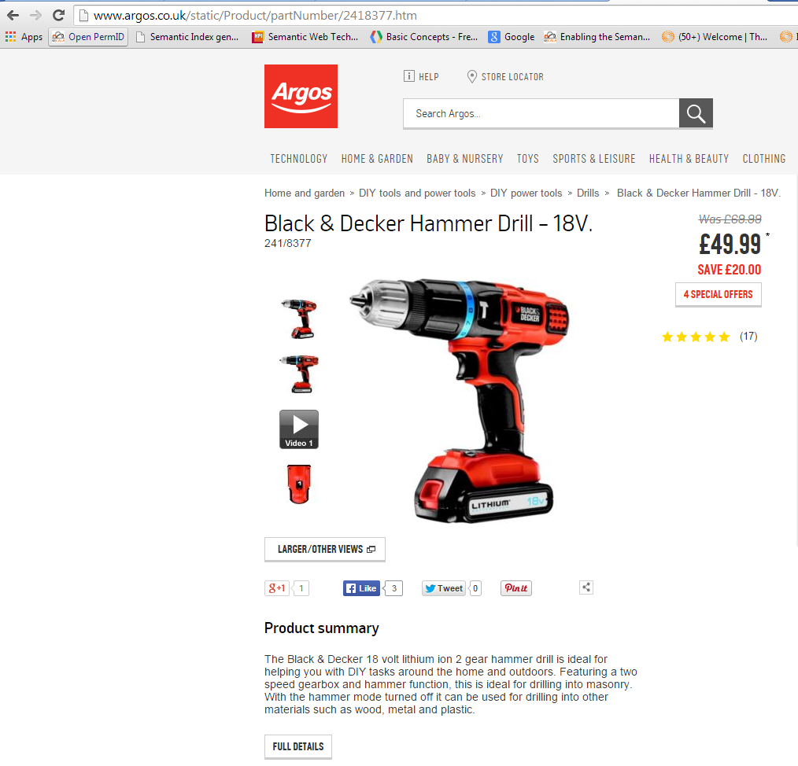
Common reference points
Notes:
Characteristics of a useful common reference point

Slide 12
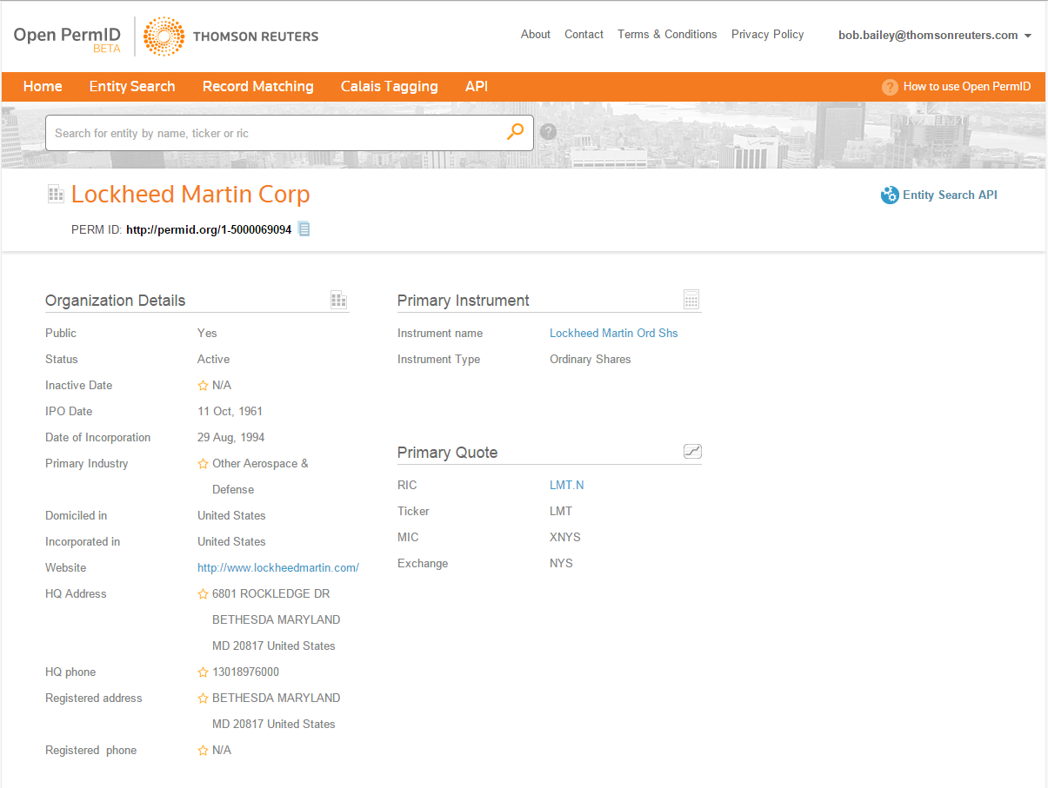
Notes:
The common reference point we’re building out internally (and hope to extend externally)

Slide 13
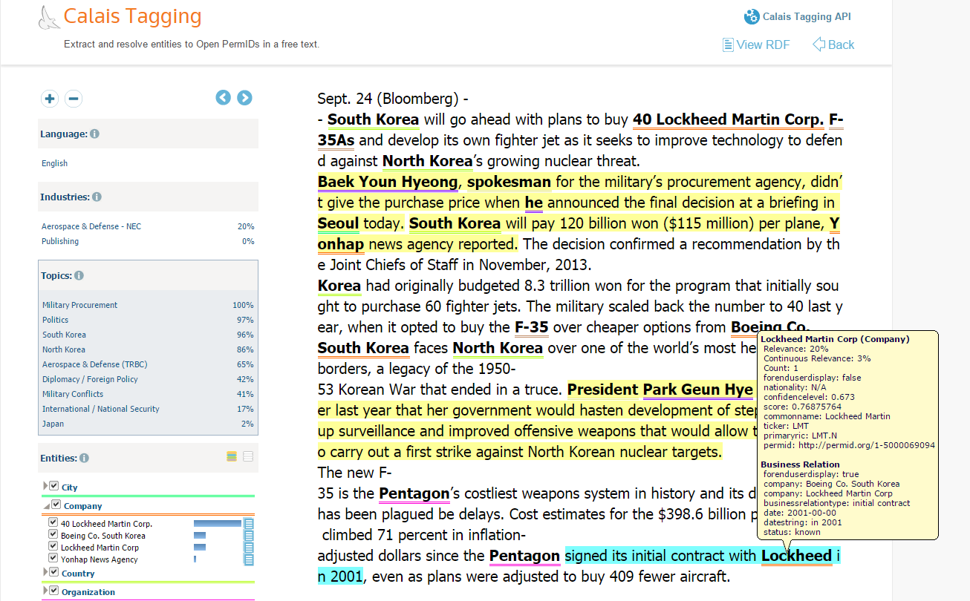
http://viewer.opencalais.com/
Notes:
Tools to make the service useful and easy to adopt

Slide 14
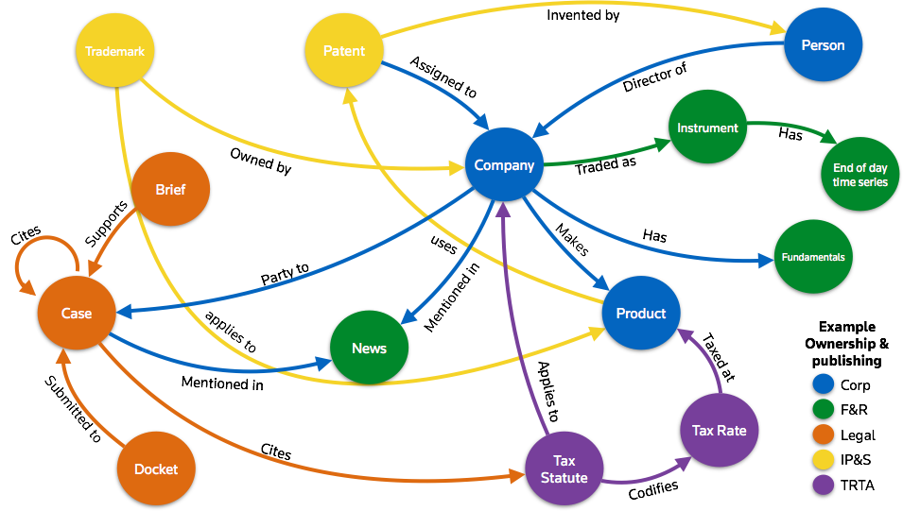
A THOMSON REUTERS KNOWLEDGE GRAPH
Notes:
Aspiration – building a TR graph

Slide 15
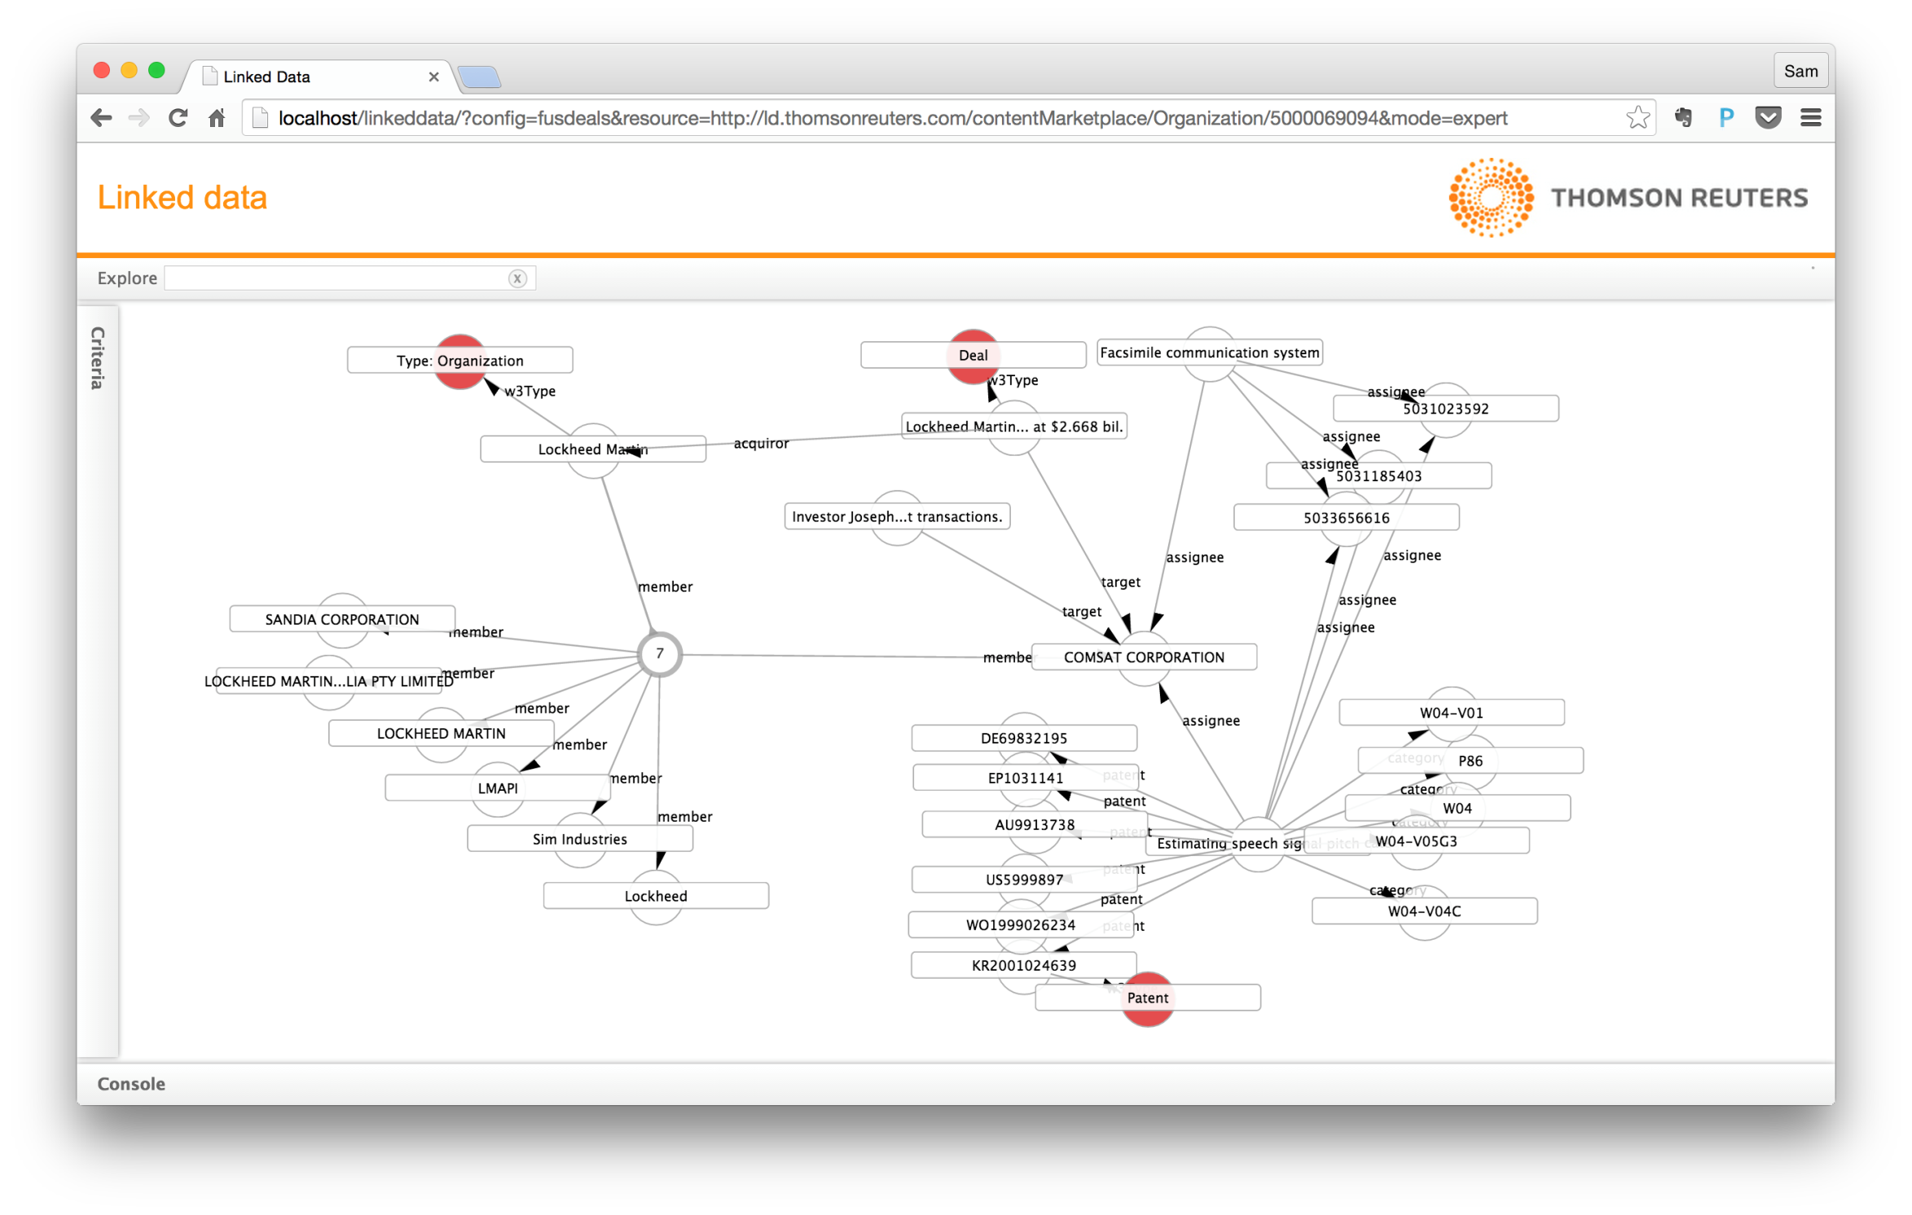

Slide 16
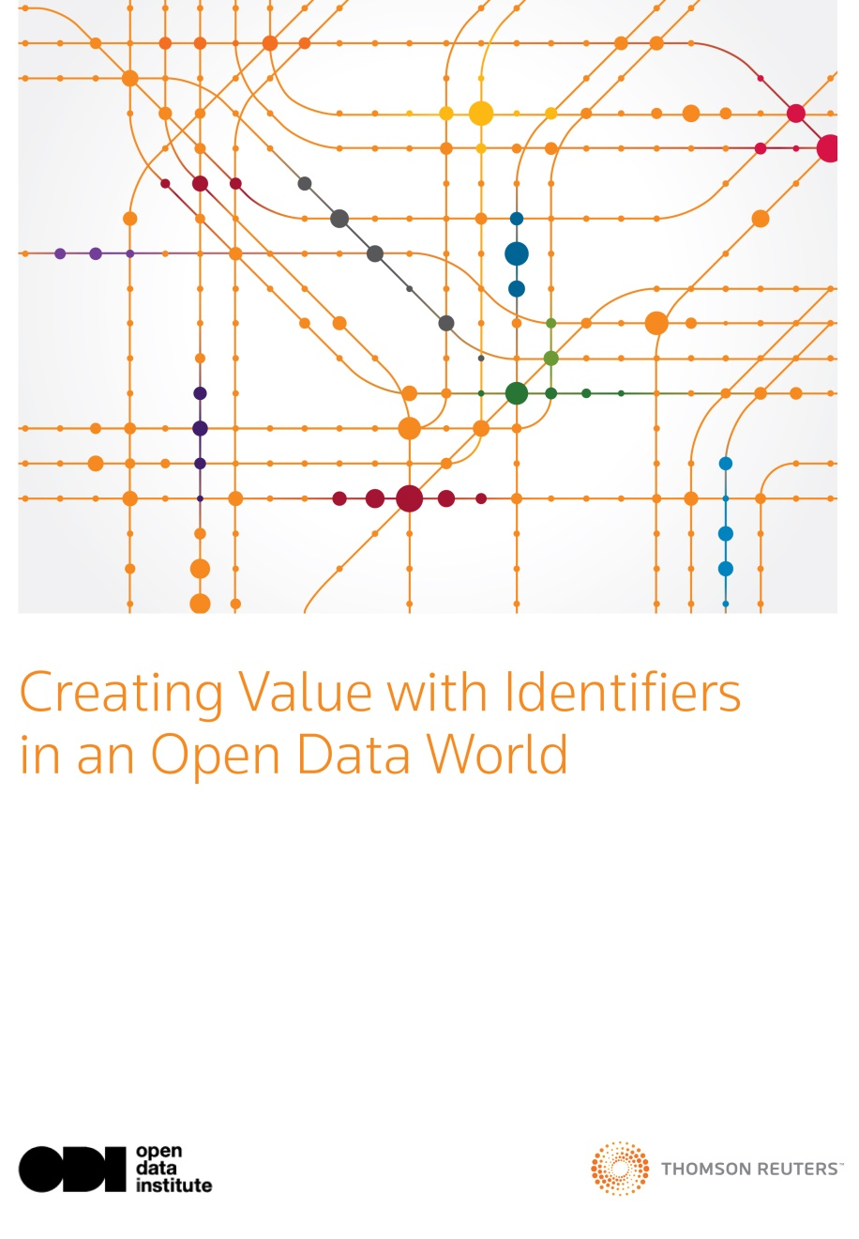
  Help to grow
  the open data commons
  Manage the complexity
  of the web
  Discover and connect
  to other data sources
  Realize the value!
http://theodi.org/guides/data-identifiers-white-paper
http://thomsonreuters.com/site/data-identifiers/

